Slide 1
An application of 24GHz radar as a means of contactless heartrate monitoring
Written and presented by: Oisín Watkins
Student ID: 15156176

Slide 2
Contents
Introduction
Theory
Design Approach
List of Deliverables
Next Steps
Project Requirements
Conclusions
Questions

Slide 3
introduction
Funded and supported by Analog Devices, Inc. Limerick.
This project is designed to be a proof of concept, demonstrating that this type of measurement can be achieved while keeping integration with existing applications at its centre.
ADI Limerick provided a Demorad 24GHz Radio Detection and Ranging (RADAR) platform for this project. This platform has been used previously in projects and demonstrations within ADI Limerick.
This project will be the latest in a series of similar projects.
Aimed primarily at use in autonomous vehicles.

Slide 4
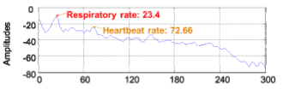
Theory
When positioned correctly the Demorad will measure the distance to the patient’s chest wall over time.
The motion of the chest wall is comprised of respiration and heart rate.
In order to successfully measure heart rate, both respiration and heart rate motion must be characterised. The respiration can then be filtered out and heart rate measured.

Slide 5
design approach
Place the Demorad 1m from the patient, parallel to their chest wall.
Use Demorad to measure distance to patient’s chest wall over time.
On the host computer save this movement data. Perform filtering and FFT on the movement data.
Band-pass filter the data according to the known limits of heart rate and respiration
Present information to user
Compare this with reference data taken from optical heart rate measurement

Slide 6
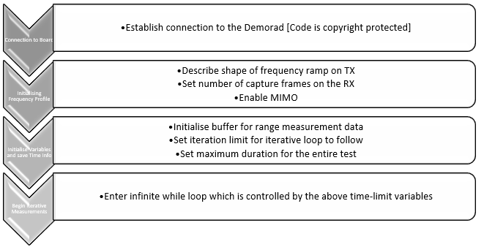

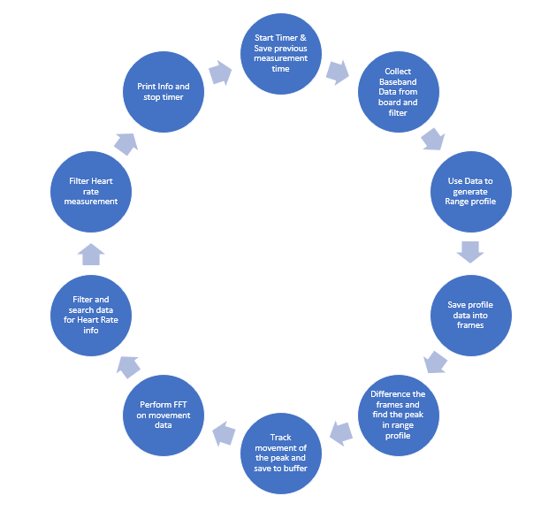

Design Approach – The Algorithm
The diagram shown is read from top to bottom
This high-level overview of the MATLAB R2017b script shows how the theory provided in the Theory section is put to use
After the initial setup and connection is complete the iterative measurement process begins.
After each iteration the updated info is printed to the screen and saved into an array. This array is then saved into an automatically generated Excel sheet.

Slide 7
List of deliverables
Objectives Reached
Objectives to Reach
Successfully communicate with the Demorad platform (November 2017 – January 2018)
Compile Bibliography and read relevant papers in research area (February – September 2018)
Develop code to take a ranged profile of the Demorad’s field of view (June – September 2018)
Investigate methods to take heartrate measurements based both on the physiological motion of the chest wall and on the means by which the previous objective has been reached (September 2018)
Iteratively improve the measurement method, basing improvements on the results from non-conclusive testing while bearing in mind the limitations of computing power and testing environment (September – October 2018)
Propose experiment to be conducted in the Anechoic chamber on UL campus to finalise improvements to the software (October 2018)
Test software in Anechoic chamber while making improvements to software based on the results. This will be an iterative process conducted over the course of weeks (Pending approval)
Verify results and compile data (December 2018 – January 2019)
Finalise the design and prepare for presentation (January – February 2019)
Present findings and design (March – April 2019)

Slide 8
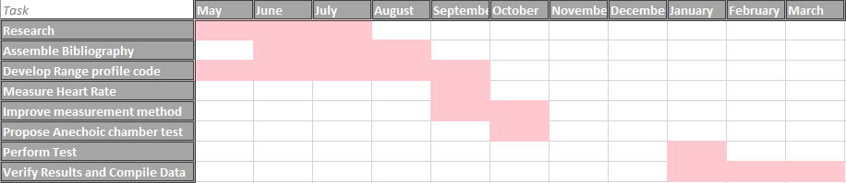
Next steps
The Gannt Chart shown accurately surmises the timeline for this project.
The remaining steps include:
Test the design in the Anechoic Chamber
Verify the results of the test
Compile and present data

Slide 9
requirements
At this stage in the project the only remaining requirement is access to the Anechoic chamber on campus.
The experiment proposal has been submitted. Everything is ready to go for January, as this is the earliest time that everyone will available to run the test.
After that point all that remains is compilation, analysis and presentation of data

Slide 10
Conclusions
Brief theory behind the project has been presented
An insight has been given into how the project has progressed and into the methodology employed
All relevant deliverables and objectives have been listed as “completed” or “to-be-completed”
A listing of the project requirements from this date has been presented

Slide 11


